Slide 1
Design and Analysis of CRISPR Class 2, Type II, V, and VI Systems as Effective Treatments for Viral Infections
A promising new technology that can combat ALL TYPES OF VIRUSES

Slide 2
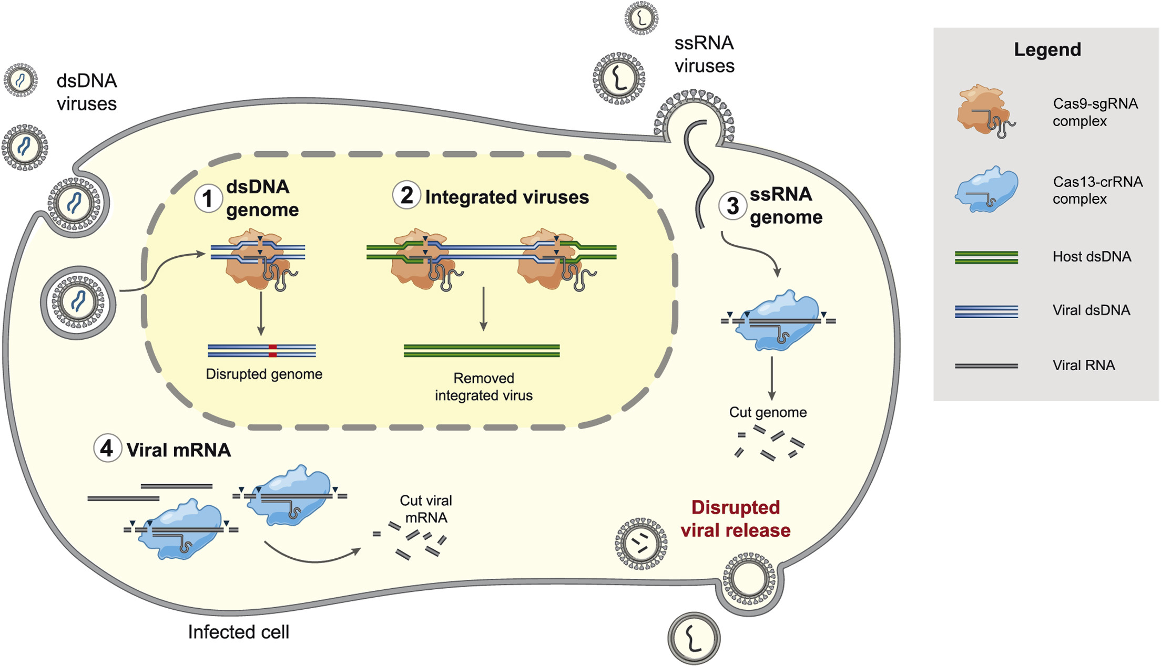
What is CRISPR?
Why is it Useful?
CRISPR-Mediated Antiviral Therapy (CMAVT)
Exploring CMAVT with
+ssRNA viruses (SARS-CoV-2)
Choosing and design of expression vectors, with their delivery mechanisms.
CRISPR applications elsewhere
Effectiveness
My crRNA
overview
Freije & Sabeti, Cell Host & Microbe, 2021

Slide 3

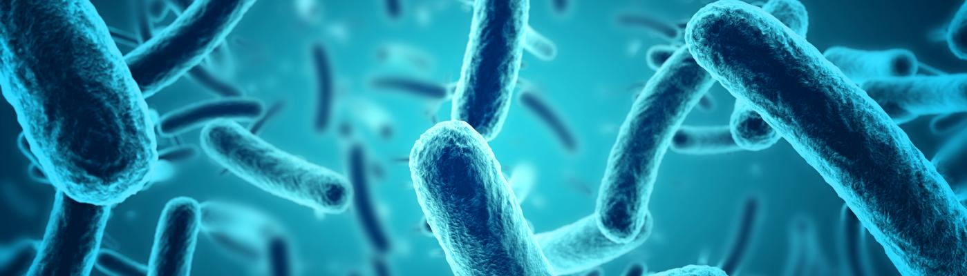
WHAT IS the crispr/cas system
CRISPR stands for Clustered Regularly Interspaced Short Palindromic Repeats
CAS stands for CRISPR Associated Proteins.
This system is an acquired immune system found in Bacteria and Archaea that directly cuts viral DNA/RNA.

Slide 4
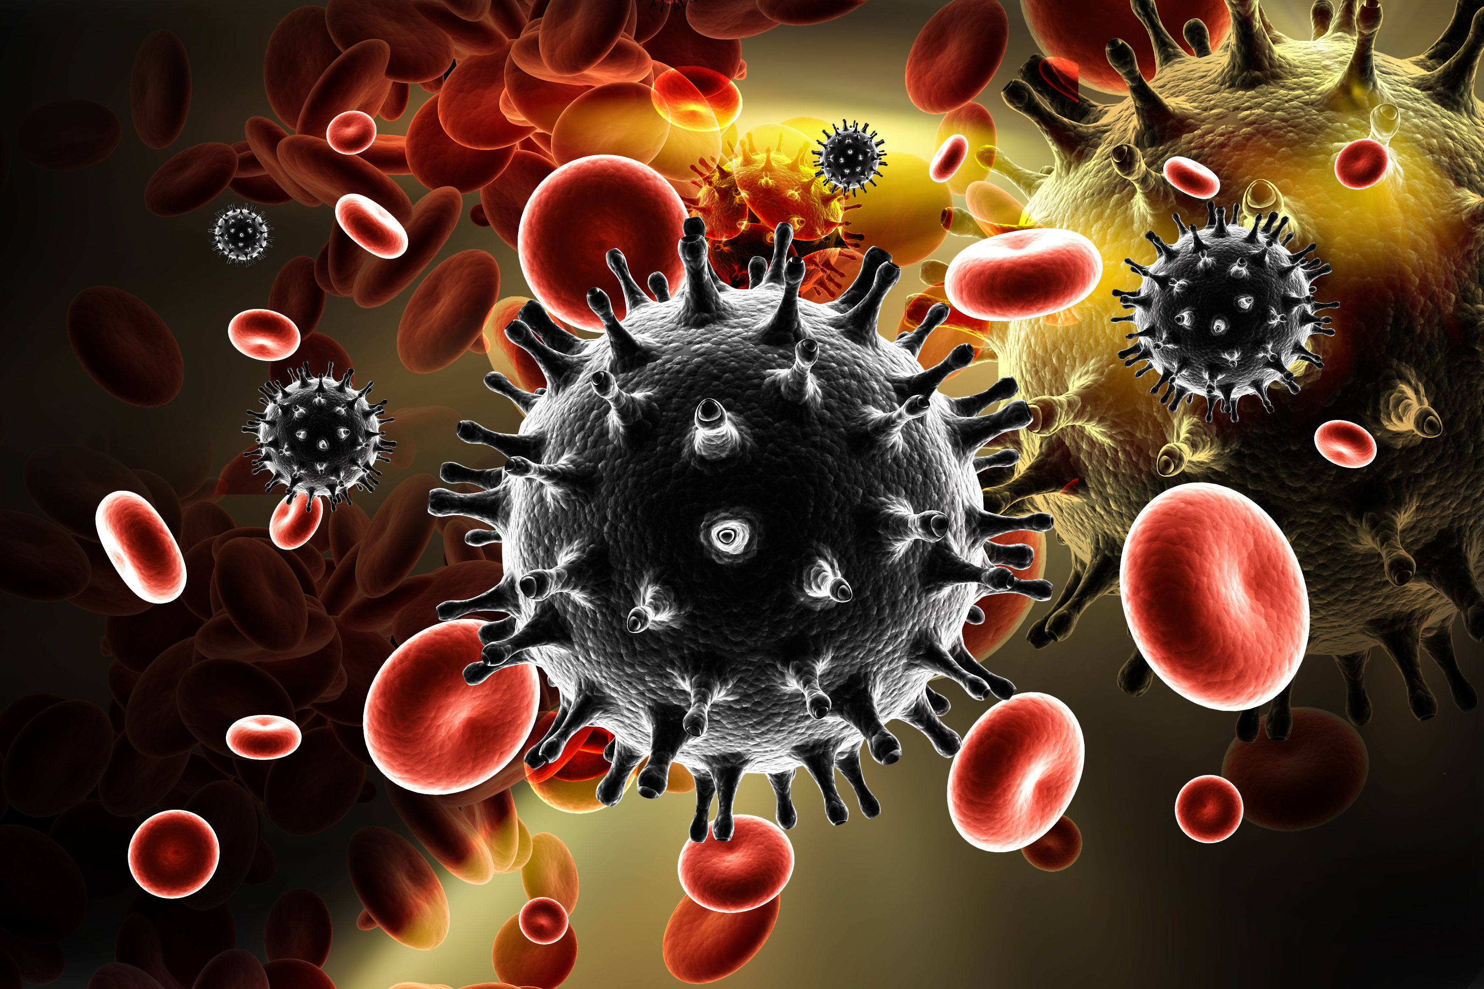
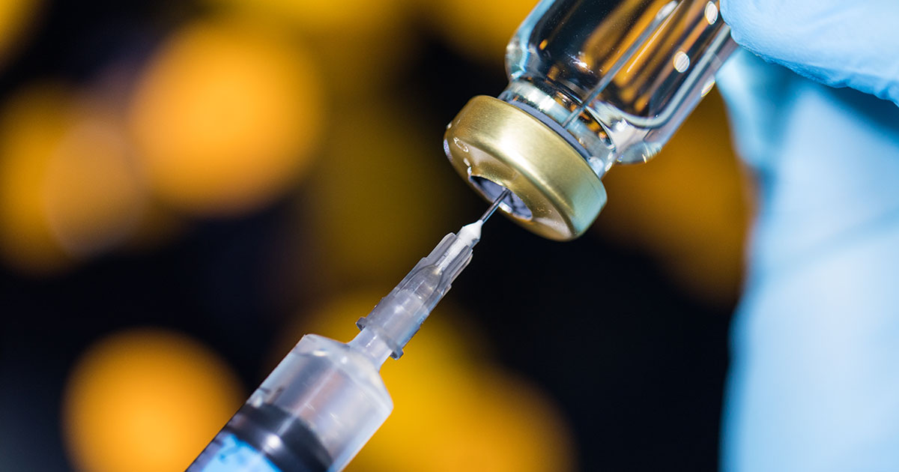
WHY CRISPR ?
Constant threat of newly emerging PPVs
Directly targets virus and supresses it.
Potential cure for latent infections (HIV)
Hard to evade by the virus

Slide 5
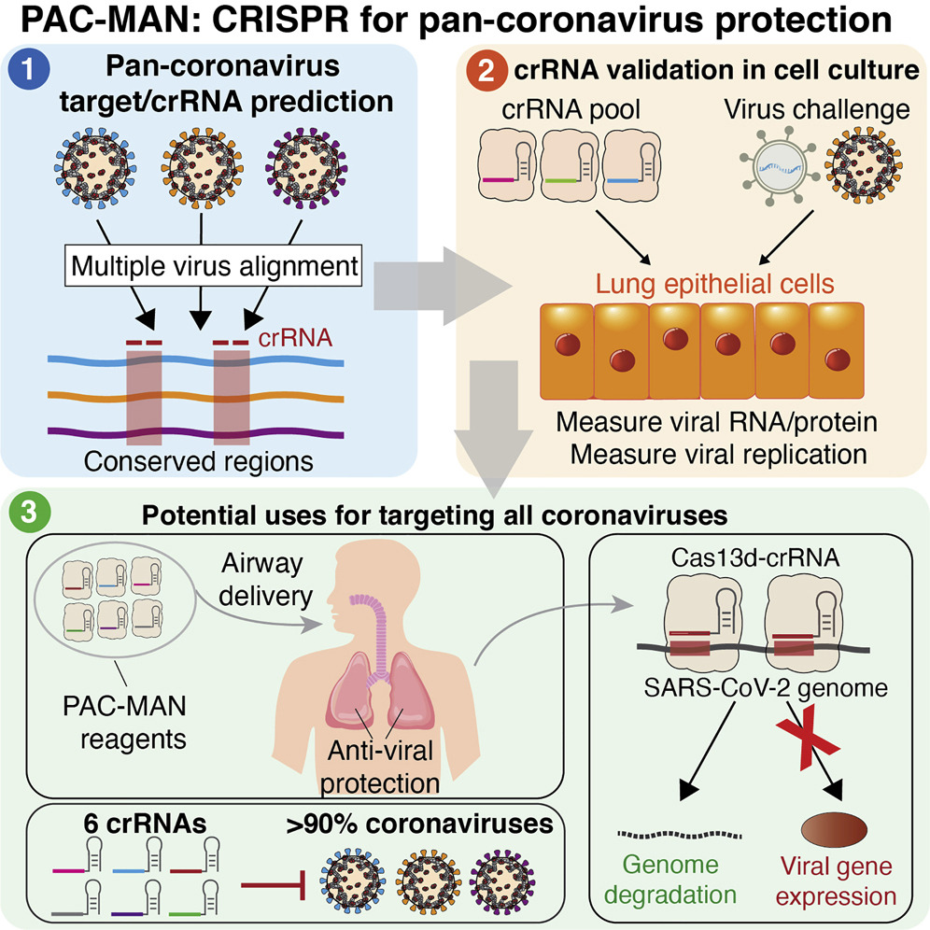
WHY CRISPR ?
Abbott et al, Cell, 2020

Slide 6
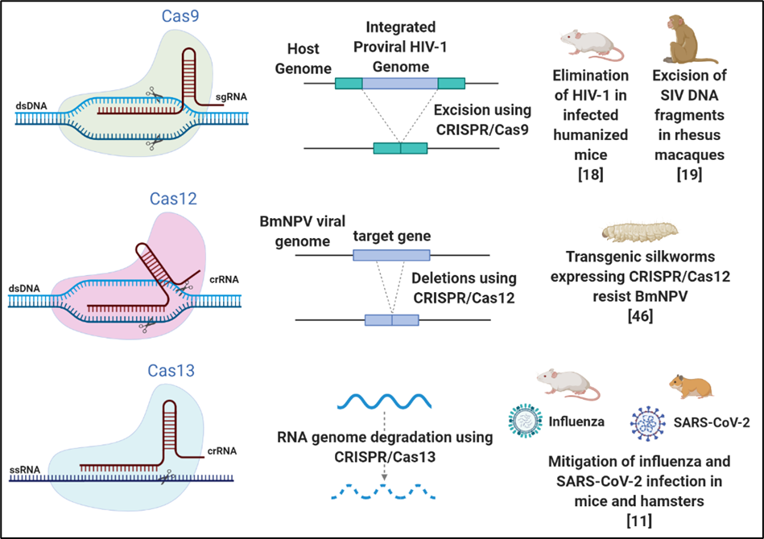
CLASS II CRISPR/CAS SYSTEMS
There are 3 systems:
1. Cas9 (Type II)
G-rich PAM
2. Cas12 (Type V)
Cas12a (Cpf1), b
5’ end located PAM
3. Cas13 (Type VI)
Cas13a, b, c
Cis and trans cleavage

Slide 7
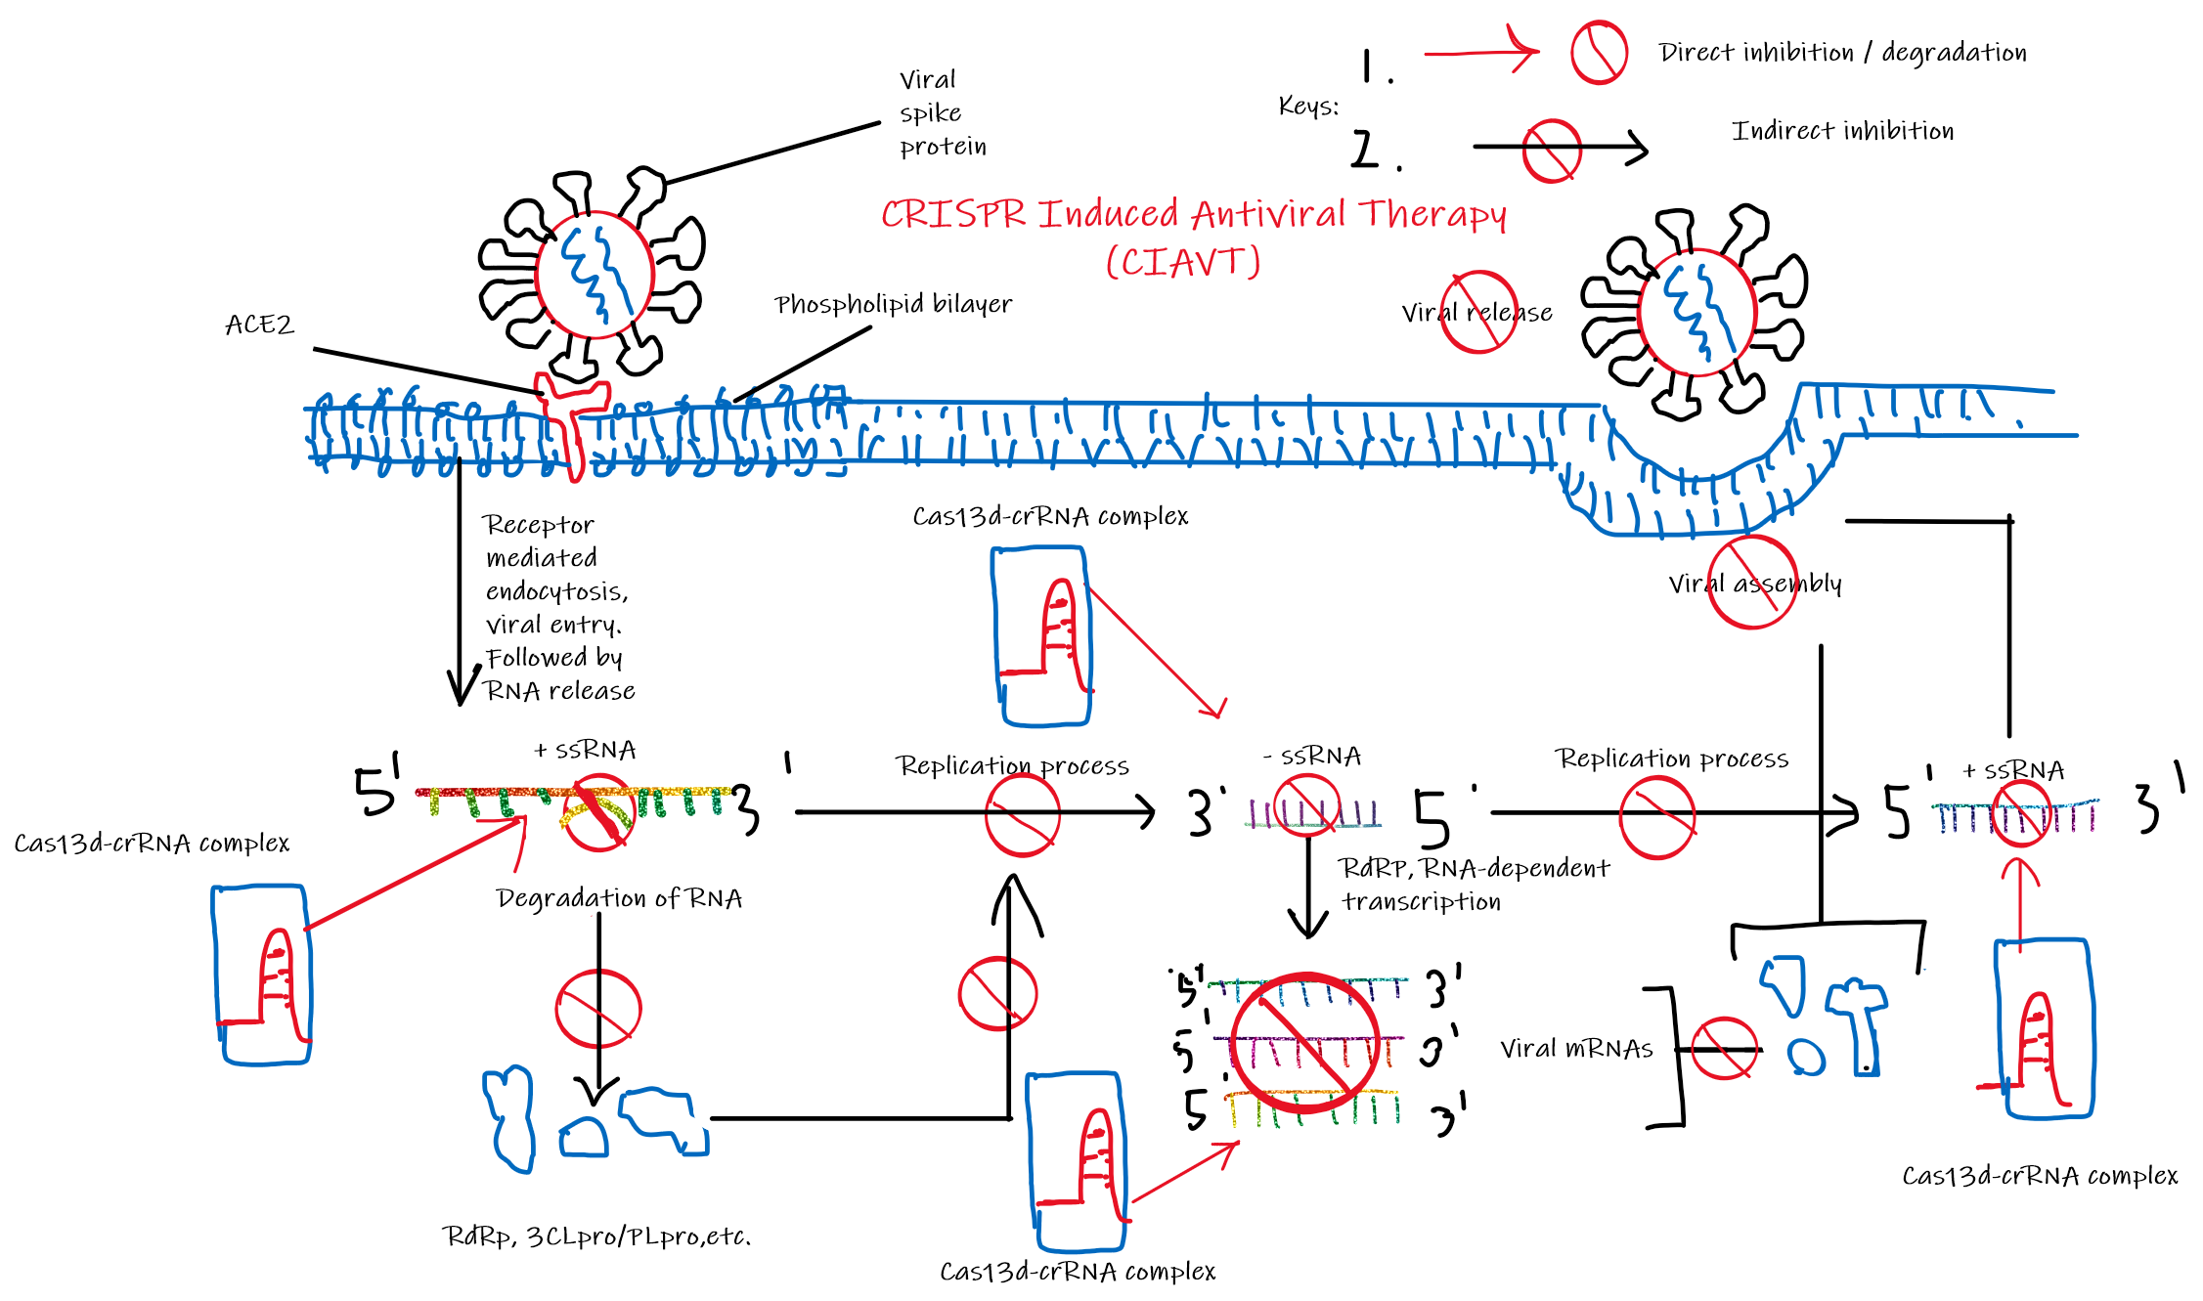
SARS-COV-2

Slide 8
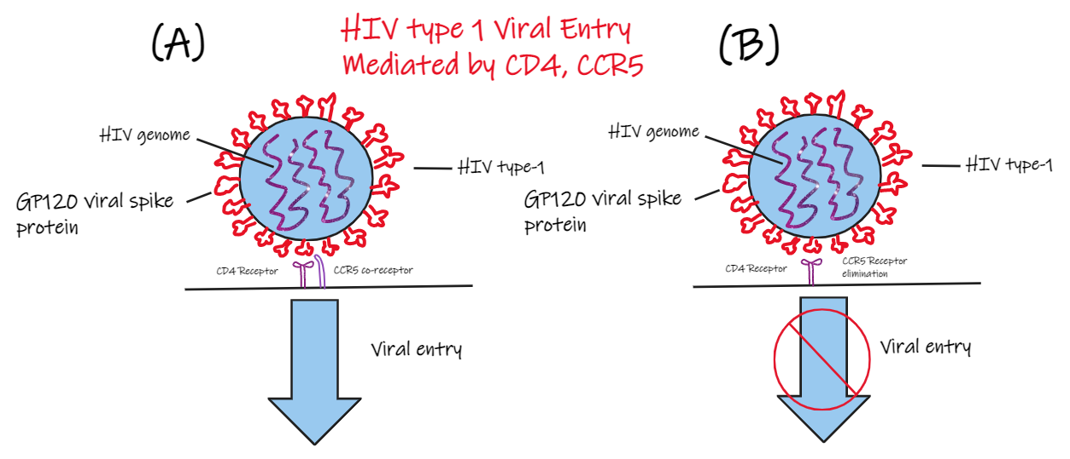
HOST FACTOR OR VIRAL GENOME ?
There are 2 general targets that we could target:
1. Host factors
Side effects may occur
Could be surprisingly very effective
2. Viral genome
More direct approach
Strong suppression

Slide 9
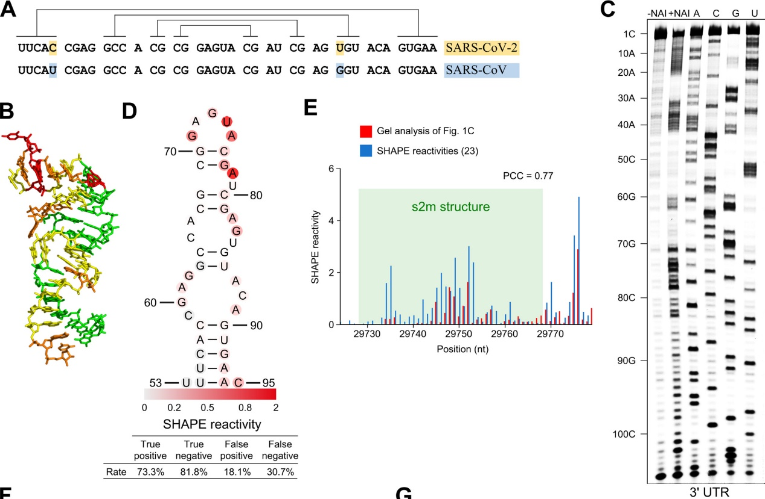
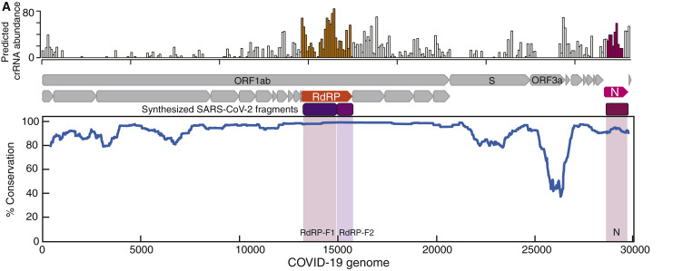
crISPR RNA SELECTION
The quality of crRNA dictates the effectiveness of the therapy / vaccine.
1. crRNA must target highly conserved regions

Slide 10
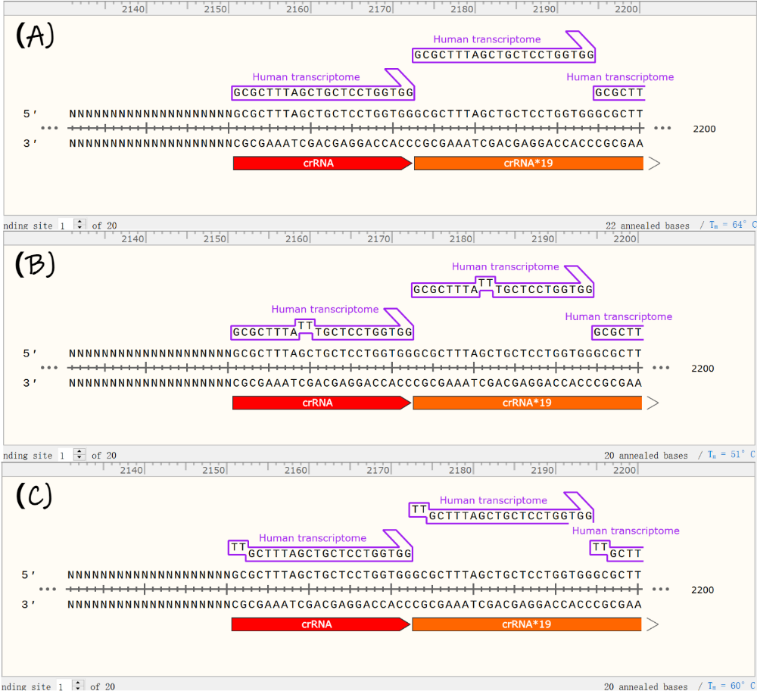
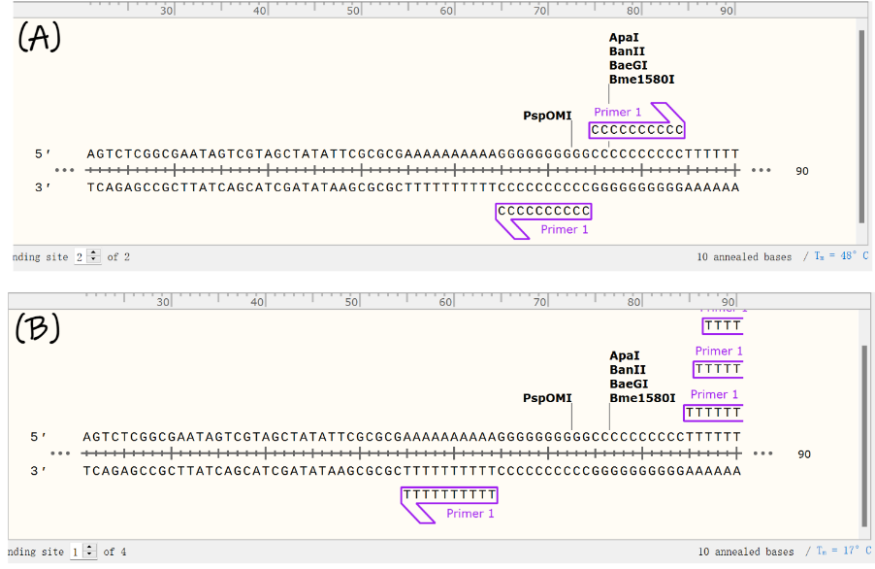
crISPR RNA SELECTION
2. No poly-Uracil sequences (more than 3)
3. Minimise potential off-target activity
Annealing temperature of at least 10°C lower with any human transcriptome compared to perfect match

Slide 11
crISPR RNA SELECTION
4. Target sequence and crRNA should have an annealing temperature of around 55°C or higher.
5. Spacer sequence 40% < GC <60%
6. Target sequence should ideally be a near perfect match with its variants and SARS-CoV.
Reinforces idea about conserveness
Ensures that mutations will not lead to evasion

Slide 12
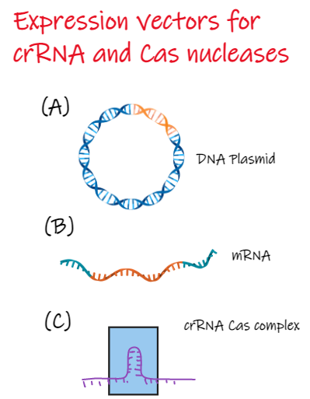
Expression in target cells
Three possible candidates:
1. DNA Plasmid
Long half-life
DNA Integration risk
2. mRNA
Short half-life
3. crRNA Cas complex
Straight forward
But too BIG

Slide 13
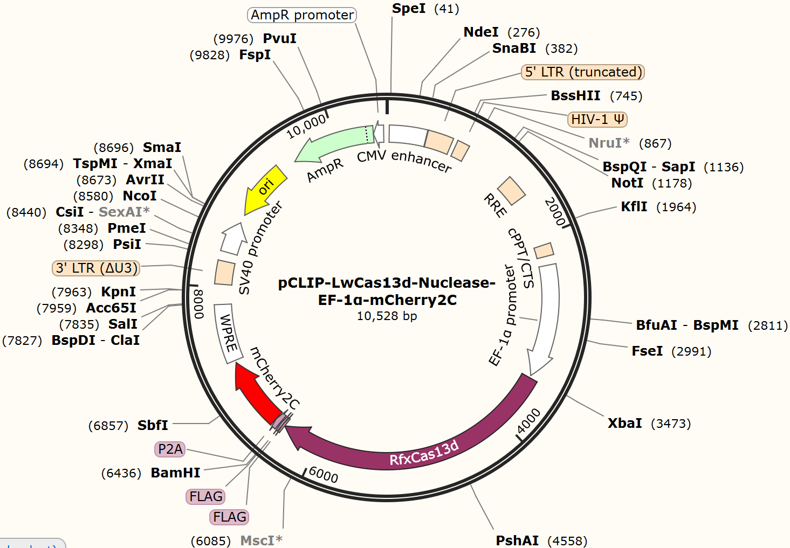
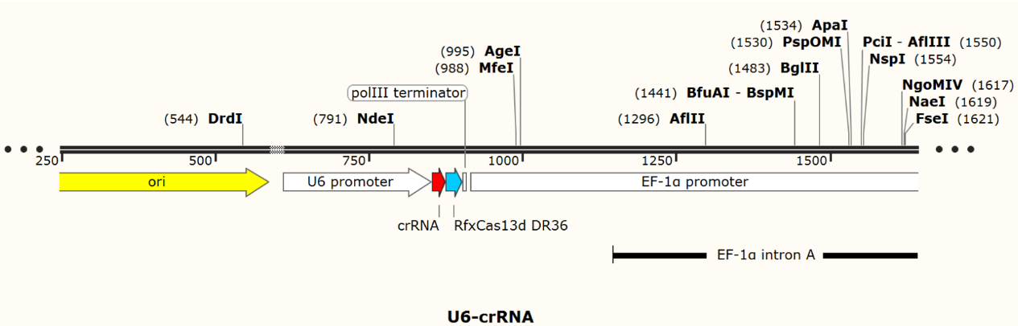
Design of dna plasmid expression vectors
Strong Promoters must be used
Fluorescent label if for research

Slide 14
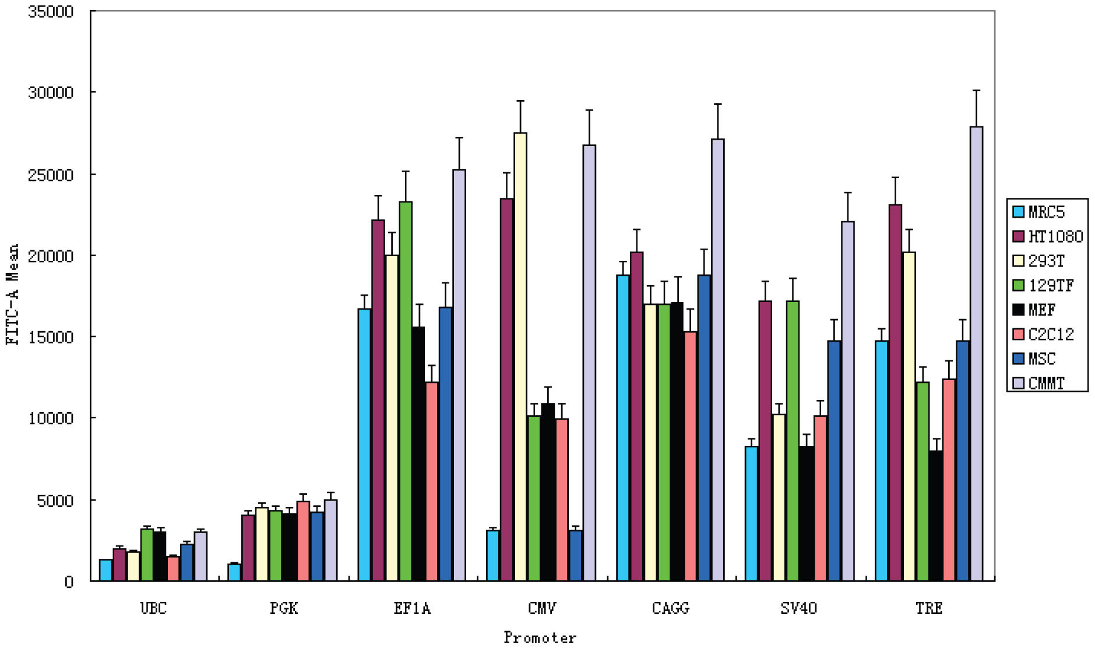
SELECTION OF PROMOTERS

Slide 15
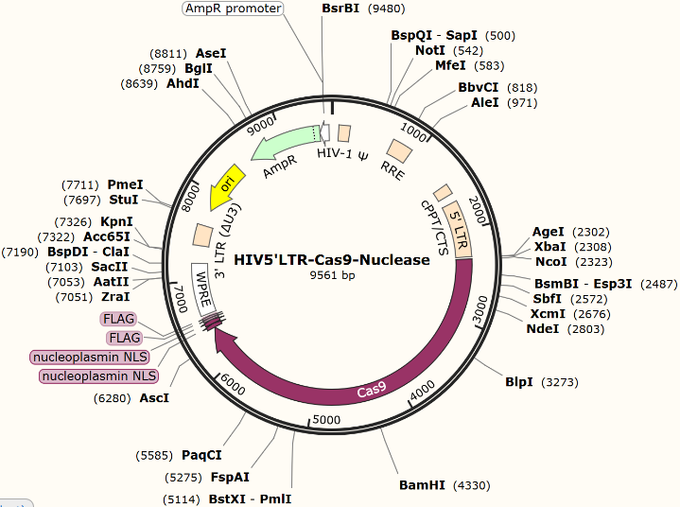
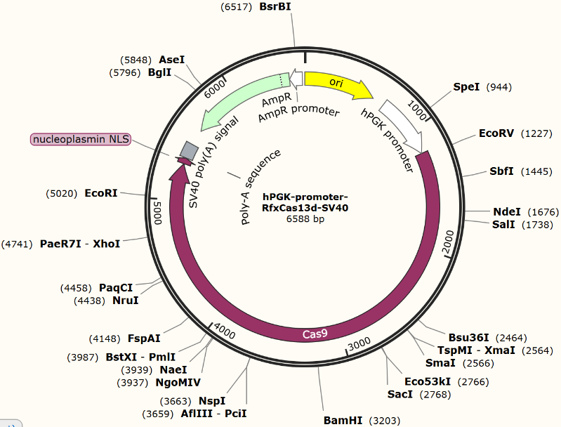
Expression vectors for HIV-1

Slide 16
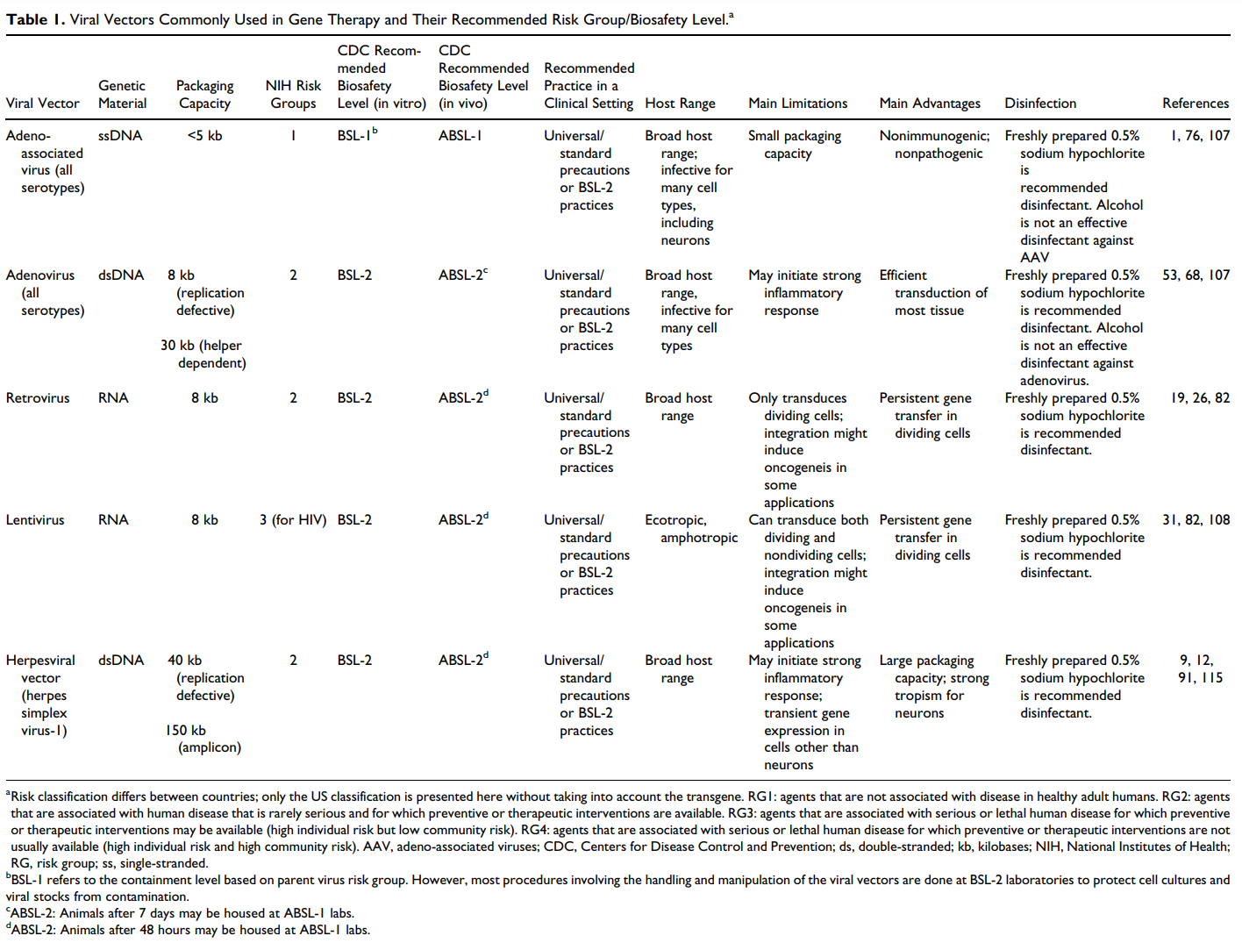
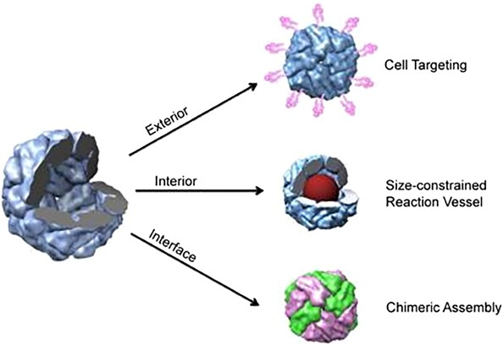
Delivering the plasmids
Viral vectors
Immune response
Specific target
Nanocages
Protein
Inorganic
Exesomes

Slide 17
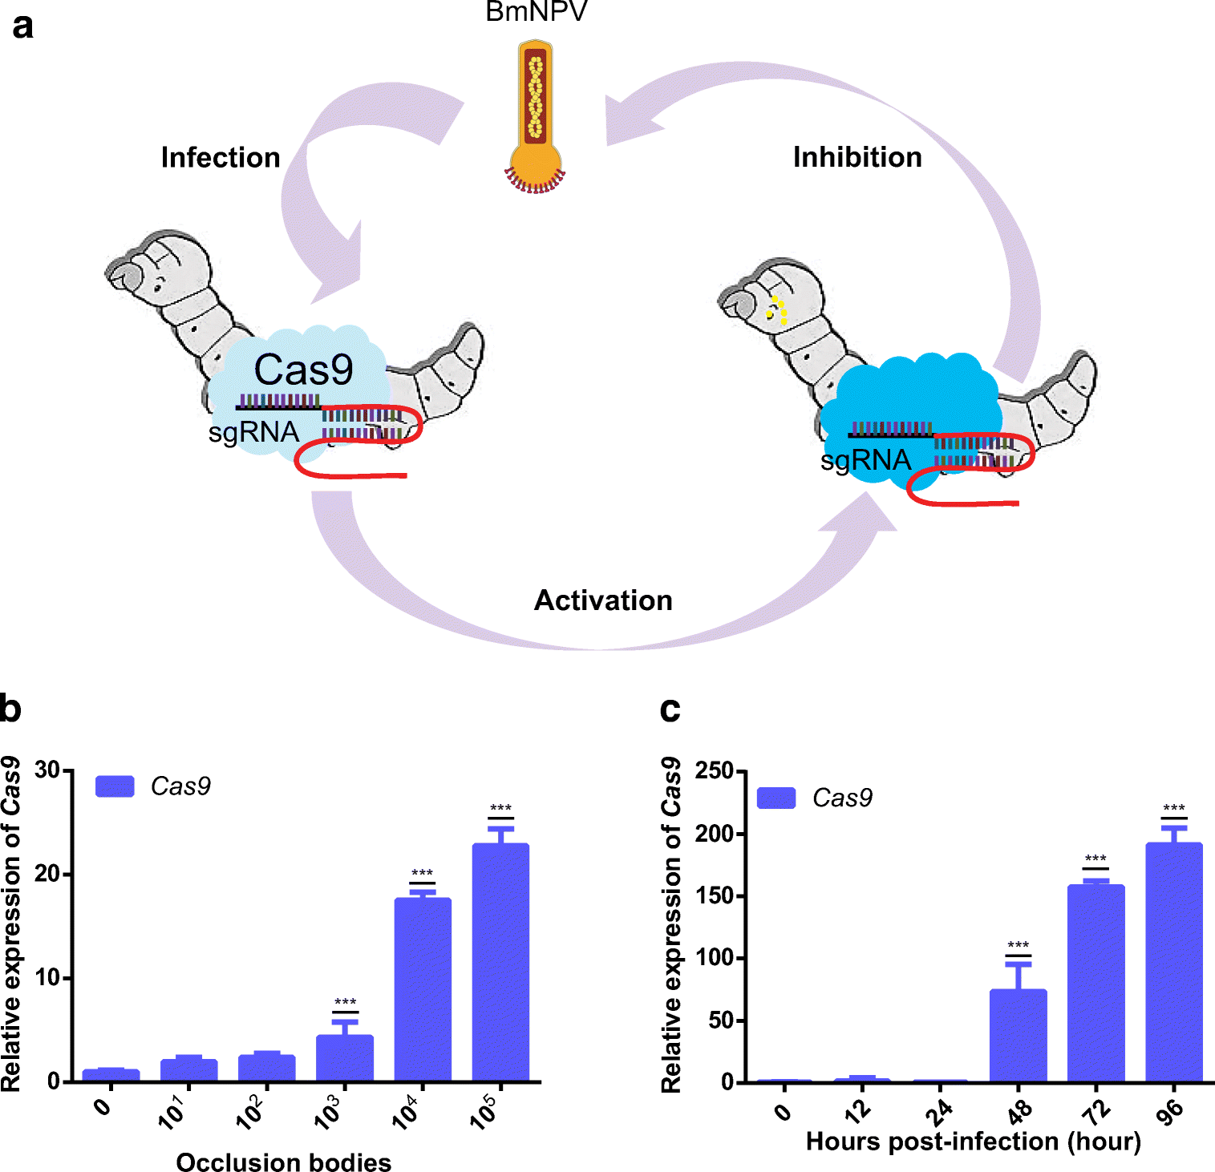
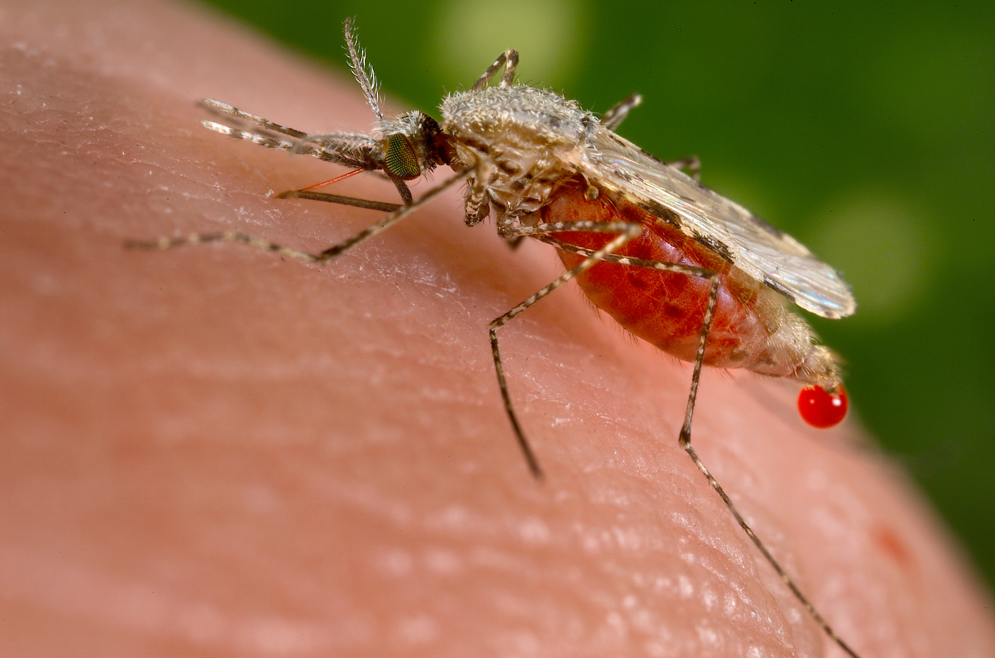
Bombyx mori
Transgenic silkworm
Aedes aegypti
Reduce vector capacity
Counter against pesticide resistance?
CRISPR APPLICATIONS ELSEWHERE

Slide 18
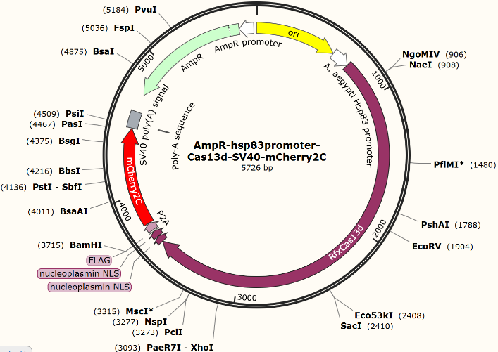
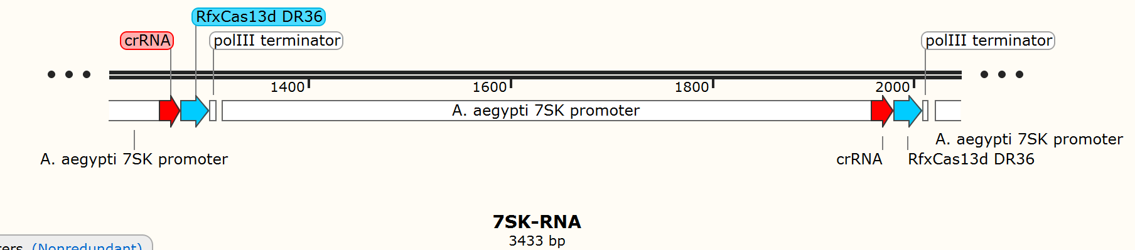
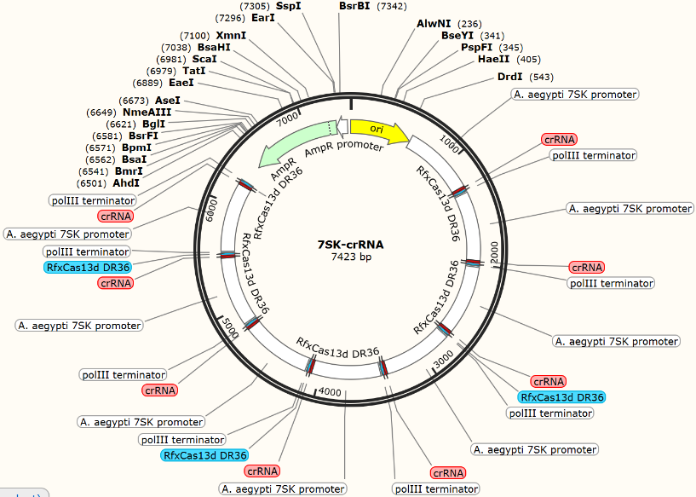
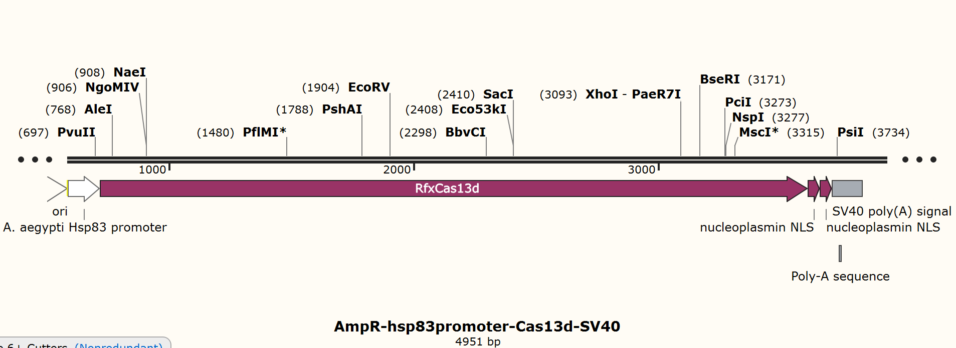

Slide 19
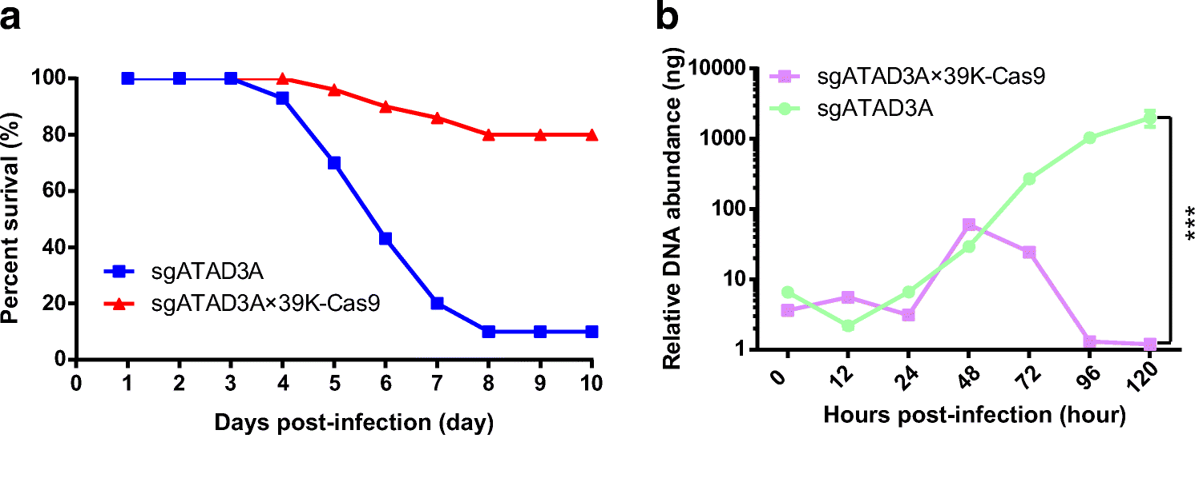
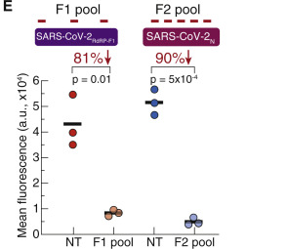
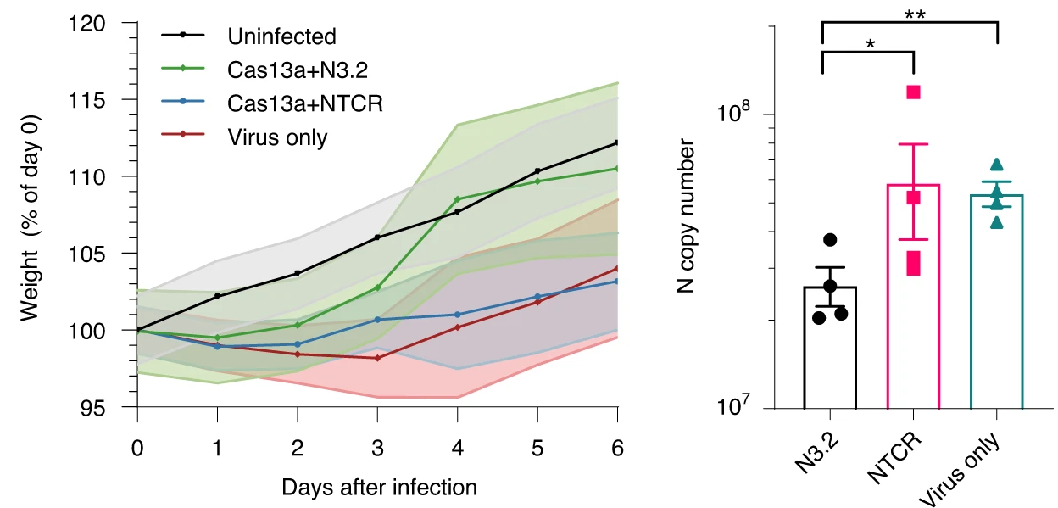
Effectiveness
Blanchard et al, Nature Biotechnology, 2021

Slide 20
TARGETING SARS-COV-2
Using the instructions I had made, I constructed a crRNA sequence to target the SARS-CoV-2 RdRp RNA sequence.
Highly conserved through multiple alignment data
From the ORF1ab section
crRNA spacer sequence: GUACUGAUGUCGUAUACAGGGC

Slide 21
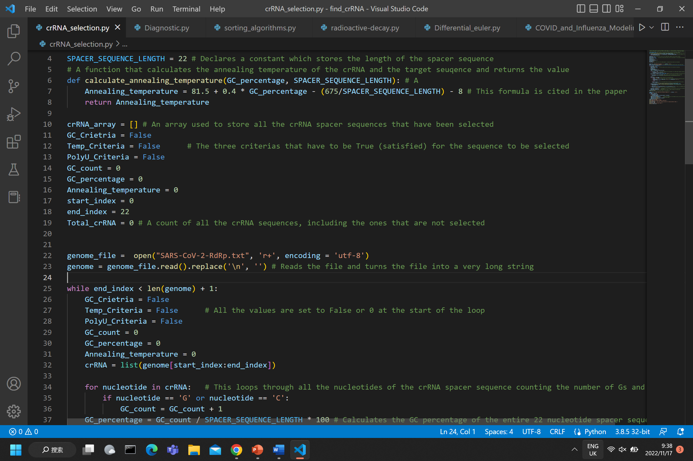
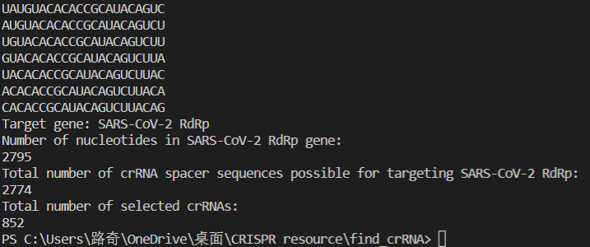

Slide 22

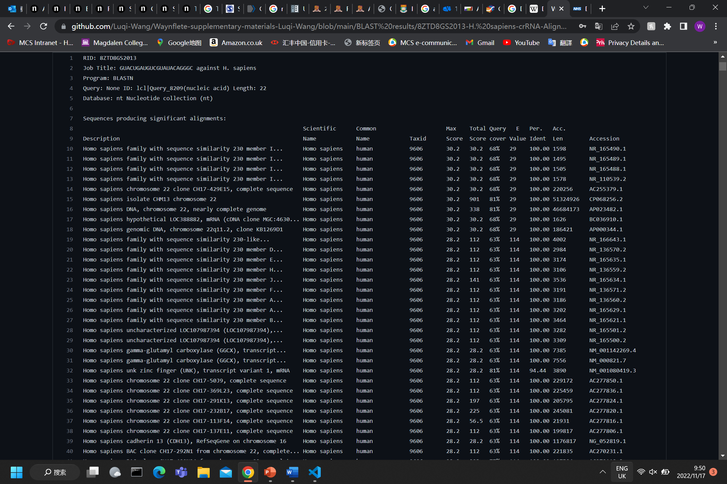
MULTI-BLAST against homo
sapiens
BLAST (Basic Local Alignment Search Tool)
Used align DNA/RNA sequences between species.
For the 852 potential crRNAs I did a BLAST
I went through the scores and alignment values of each and selected the lowest alignment score.

Slide 23
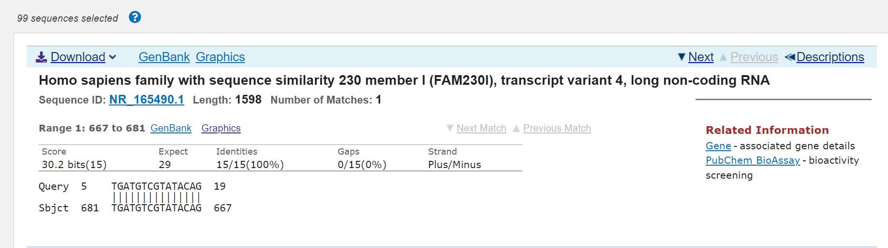
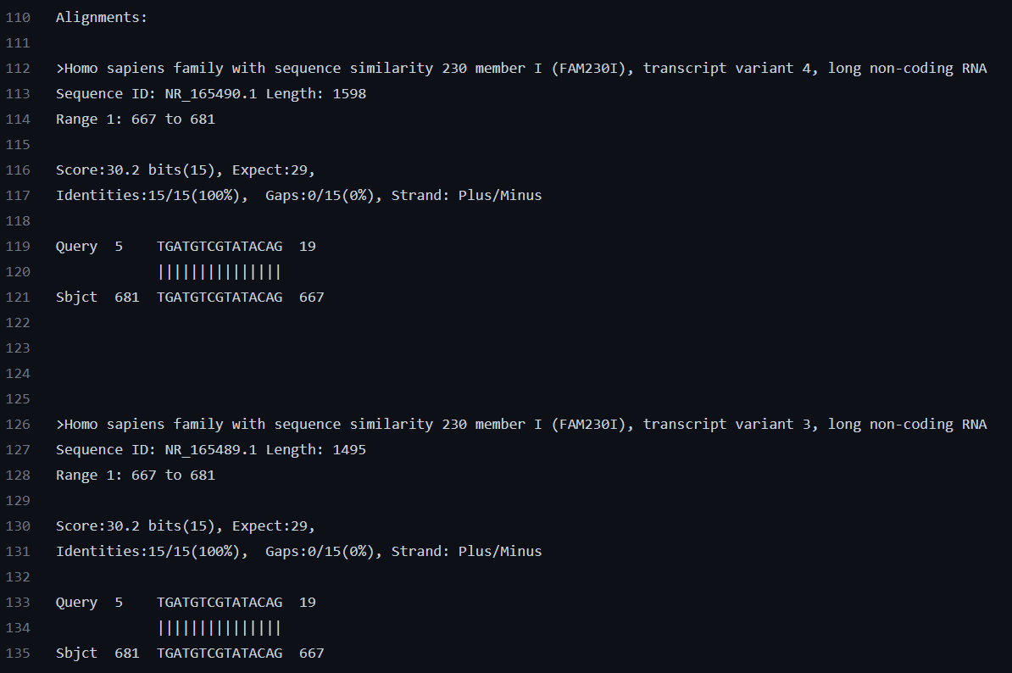

Slide 24
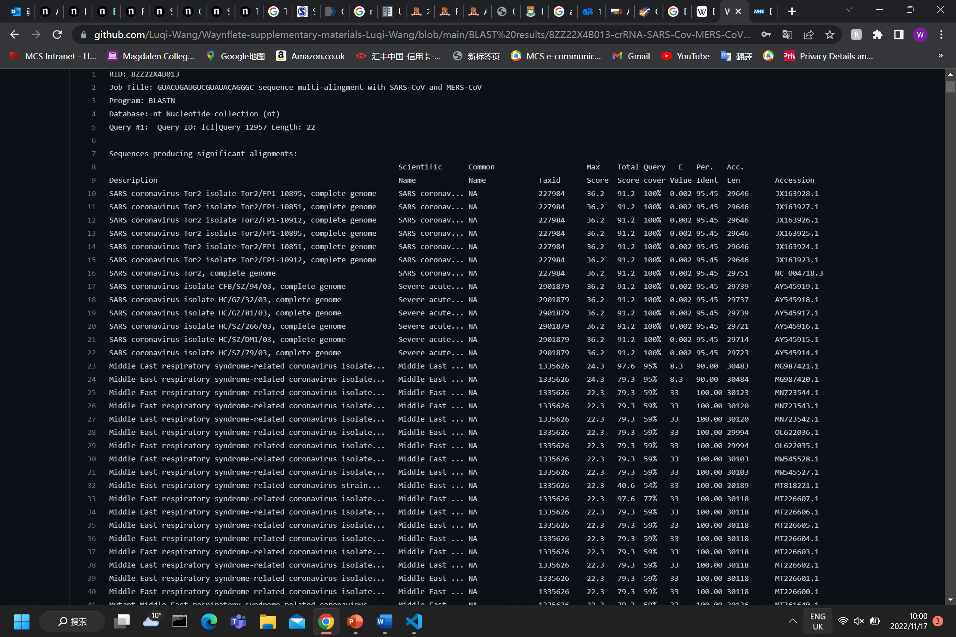
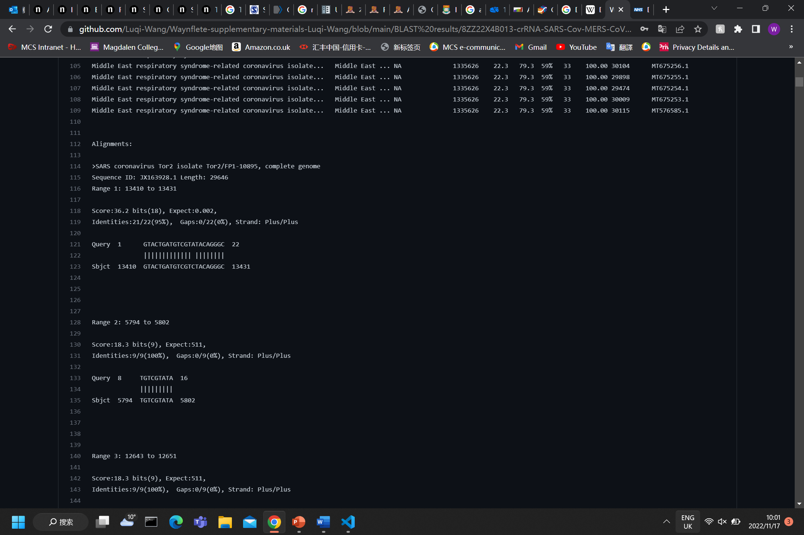
MULTI-BLAST against sars
and mers
BLAST (Basic Local Alignment Search Tool)
Used align DNA/RNA sequences between species.
Highest alignment score selected

Slide 25
conclusions
A very promising technology
Very flexible, short time period to develop.
Its effectiveness already proven in animals (Bombyx mori) and plants.
Effectiveness already proven in mouse, and human cells in vivo, suggests could also work in humans.
Strong suppression of viral load.

Slide 26


